Slide 1
Hannah Cockroft MBE,- Two-time Paralympic Gold Medalist, Wheelchair sprint athlete and BT Ambassador
e-Access 13
Notes:
Hannah Cockroft MBE, Wheelchair sprint athlete and GB Paralympian
Hannah first started wheelchair racing in October 2007, and immediately fell in love with the speed of the sport. Specialising in sprint distances, Hannah showed her potential when she broke four world records at the 2010 British Wheelchair Athletics Association International.
She continued to make history as the first athlete to set a world record in the Olympic Stadium in London in May 2012, recording a time of 19.56 in the
T34 100m. She later reduced that time to 17.60 at the Swiss National Championships.
Hannah shone on her Paralympic debut, becoming ParalympicsGB's first Athletics gold medallist of the London 2012 Games as she won the T34 100m in a Paralympic record time of 18.06. Her second event, the T34 200m, took place on what would later become known as 'Thriller Thursday'. After setting a Paralympic record of 33.30 in the morning heats, she set a new time of
31.90 in the final to take her second gold medal of the Games.
In addition to her performances on the track, Hannah has also competed at national level in seated Discus and Wheelchair Basketball. In the 2013 New Year's Honours, she was awarded a MBE.

Slide 2
Adam Oliver, BT’s Head of Disability and Inclusion Research
e-Access 13

Slide 3
We are proud of inclusion and 2012 was an inspiring year.
It is our honour to be part of the delivery of the Games

Slide 4
Since the First World War we have been inclusive

Slide 5
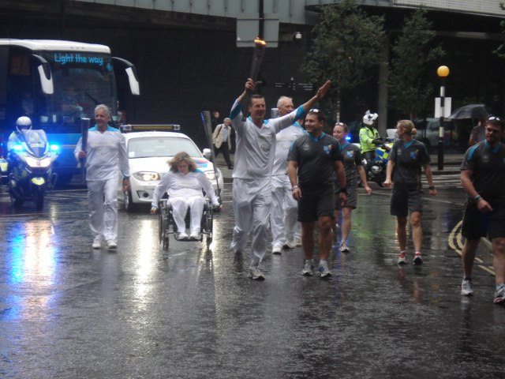
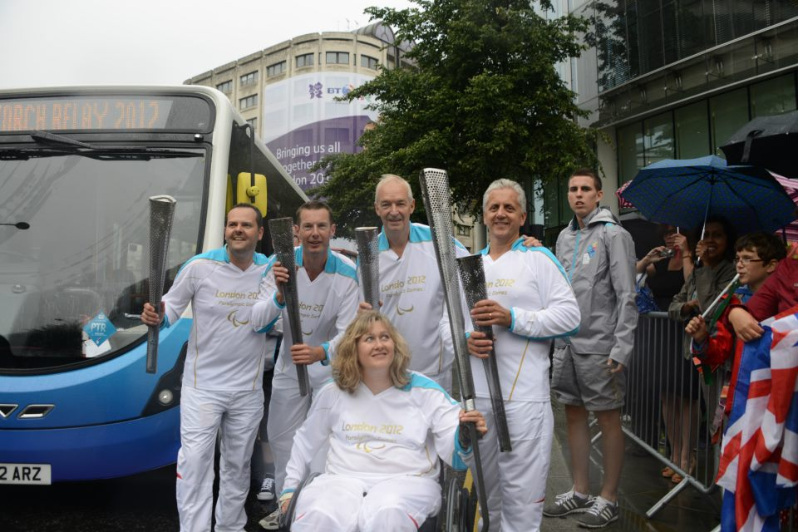
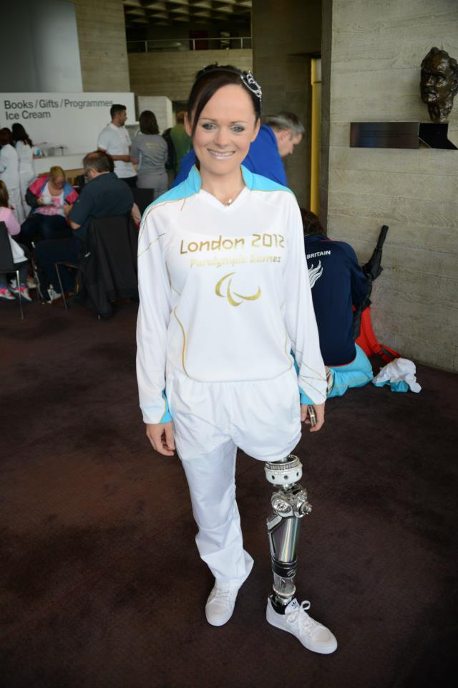
We each had our own experience of the Games
Notes:
Adam running with the Paralympic Torch http://www.facebook.com/media/set/?set=a.10150990424916829.416100.696626828&type=3&l=2708753f16

Slide 6
What have we done since with that inspiration?

Slide 7
We worked with inspiring people

Slide 8
Remember our work with Scope around creating the best communication device?
Notes:
www.scope.org.uk

Slide 9
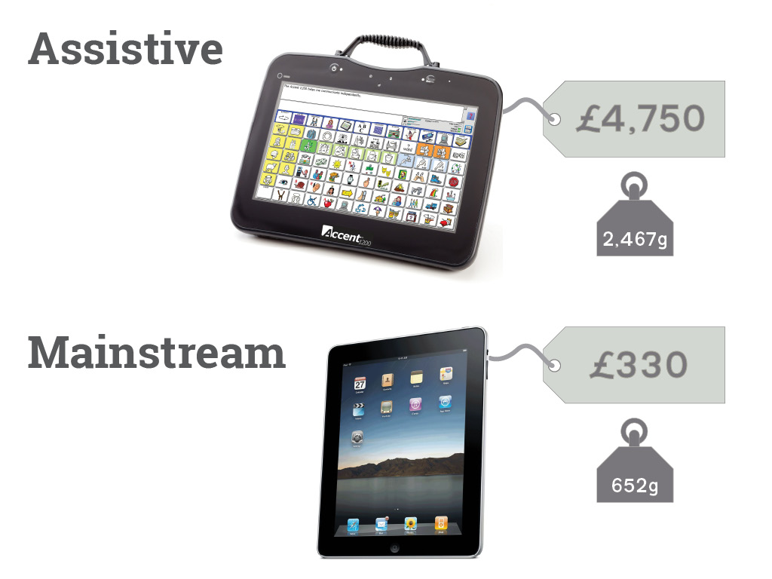
Notes:
Reducing the cost of expensive devices

Slide 10
We did this because we were inspired by Nat Sides

Slide 11
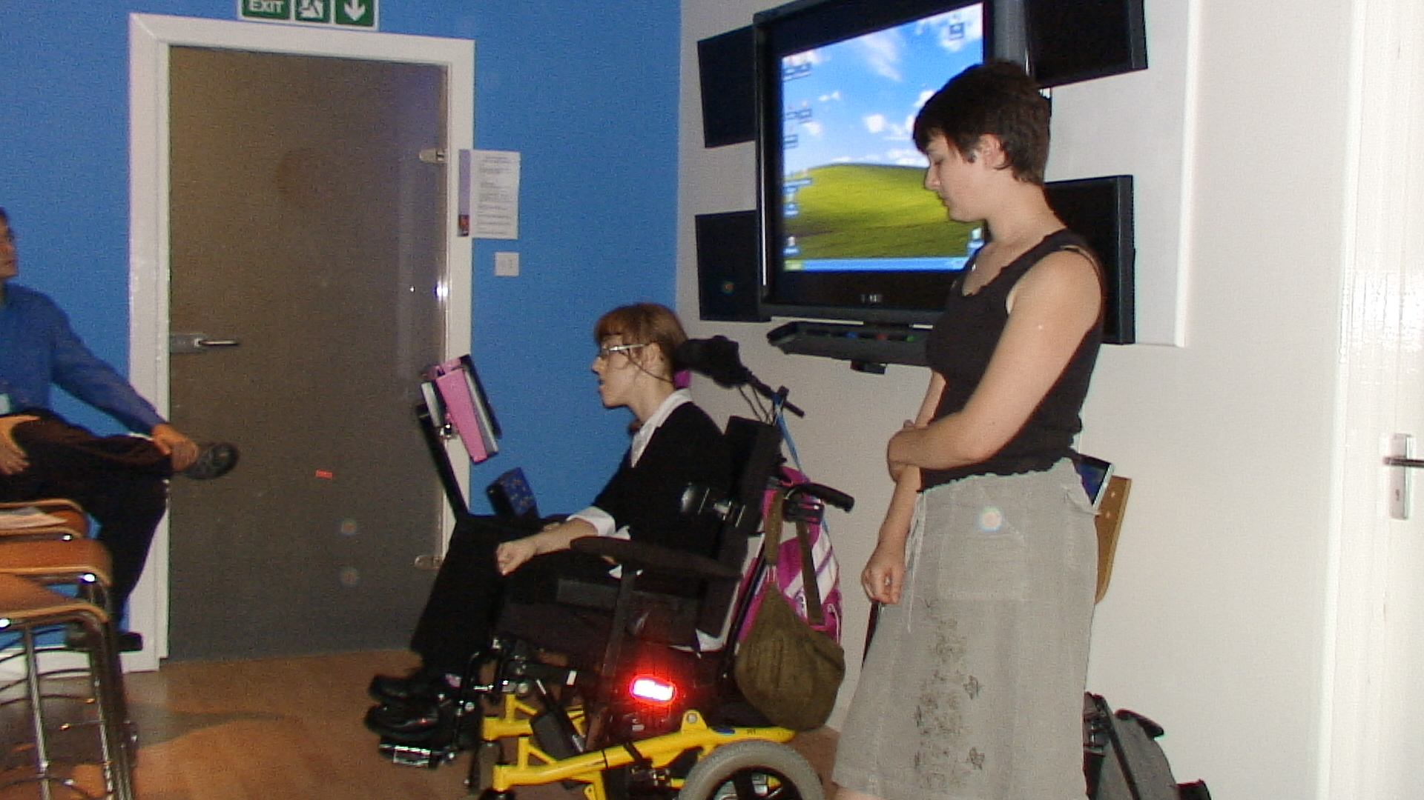
Notes:
This is Natalie giving a speech during the visit. She had typed it out on her computer by moving her right leg left and right to select individual characters. She then commanded the computer to read out the speech using the text to speech on the computer. If you want to see an inspirational speaker, see someone who has taken days to type it out.
This is Natalie’s speech she gave
Hello my name is Natalie Sides. I was born with a disability. I could not to talk to people. I met a speech therapist called Helen when I was ten months old.
When I was two I went to special school called George Hastwell in Barrow where I live, there they gave me an Orac which is a grid of words that spoke when I scanned the symbol using a head switch. Helen gave me a spelling chart which I used by focusing my eye on each letter to spell a word, It was very hard. When I was five I went to a mainstream school, because they found out that I was really bright.
At the age of six they realized I could use my leg to switch, so they asked me about trying to drive a power wheelchair with a special control box; it is great to drive myself about because it gives me my independence.
When I was eleven, I got a Cameleon, this is a type of communication aid, but it brakes down a lot which makes me really angry.
I feel like someone has gagged me when it has go away to be fixed.
I made a film called Gagged for a film competition. It was about me being gagged when my Cameleon brakes down and I was nominated for best actor. We went to Blackpool to celebrate our success. Here it is <Natalie then showed a video>.
I was on TV show called ‘How They Do That’ and I met Eamon Homes. He was a really nice guy. They filmed me doing lots of things at home and at school. When I first got a Cameleon I used the Talking Screen for Windows. They found out I could read, so when I was eleven, I went to a school called Walney Comprehensive and I did two GCSE exams. I got a C in food technology and a D in science when I left.
I then went to Star College in Cheltham, but I was not happy there and decided to leave;
Now I am at Beaumont. In my forth year. At first I felt really scared until I met a young lady called Ali who was my Keyworker. She has helped me to get over the past and make lots of new friends.
I went to ‘One Voice’ conference in Leicester with Mrs. Fix It who is Linn and all my friends for the weekend. One voice is a charity that supports people who uses communication aids. It was a great weekend. I listened to stories. I went to a ‘Communication Matters’ conference in Leicester for few days. I saw some my old friends and I have had a look at some programs to make my Cameleon easier and quicker to use, but there were problems getting the Cameleon to work. After a lot of talking about what I wanted to be able to do, Kate and Rohan made me the wheel top.
The wheel top is not just a communication aid that I can use to talk but it has also allowed me to play my own CD’s, for the first time in my life.
At present I am a part of a Voc Ops group called Activ8. We do a newsletter every half term. I am good on a computer and I can work on my own and it’s great. I can E-mail people that something I wanted to do for years. I want a computer, when I leave, with controls I can use. I want to buy a house. I hope to soon have wireless computer access to the internet through the WheelTop. So I can be independent and I don’t have to ask some one to plug my switch into a different computer.
We still need to do some more things to make the WheelTop better.
I used to have a voice called Betty and it was much clearer than this one. So we have to doe some work to find a better voice. I want a camera built into it like on a mobile phone. I’d like to be able to have environmental controls built in to it so I can turn the TV on and watch DVD’s and videos.
I’d like a mobile phone card so I can send and receive texts, and chat to people.
Thank you for listening, and I hope you will do what you can to help us.

Slide 12
Then we worked with Scope on independent living to help people use everyday technology with an assistive interface
Notes:
Nat was enabled to communicate by our work with Scope, check out the videos at http://www.danielmoses.com/film/charity/scope/index.html

Slide 13
That was also fun

Slide 14
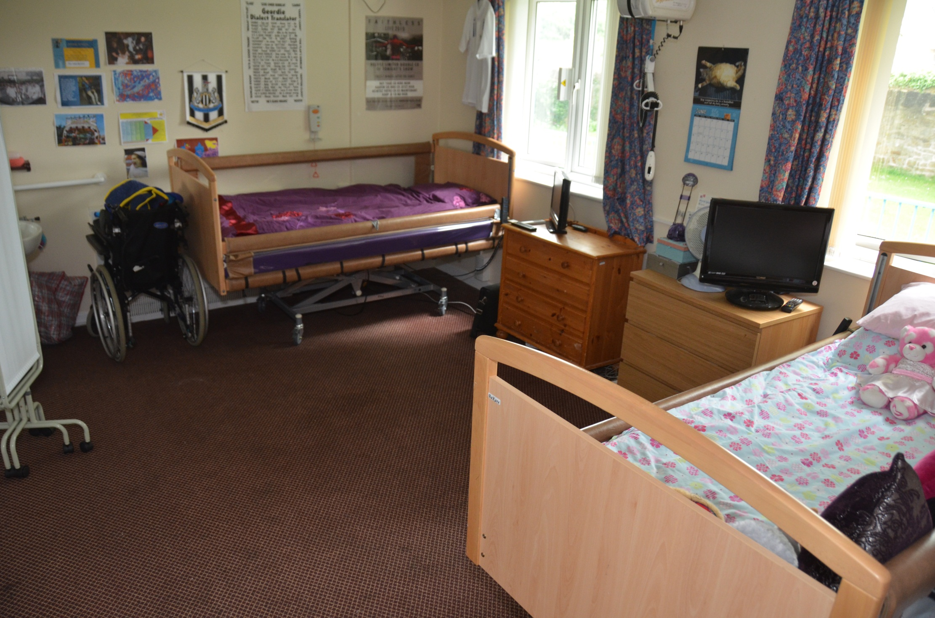
Notes:
One of the students bedrooms

Slide 15
And we worked with the RCA Helen Hamlin Institute to look at barriers to technology and we did a nice report at www.scope.org.uk

Slide 16
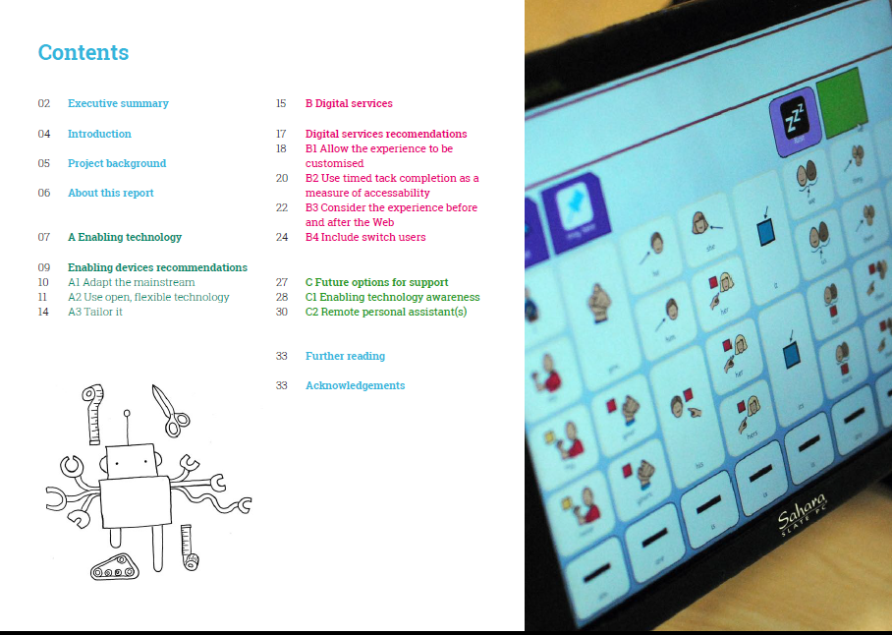
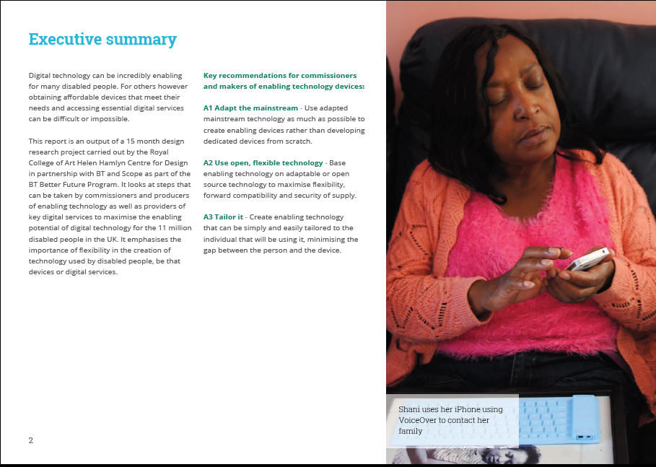
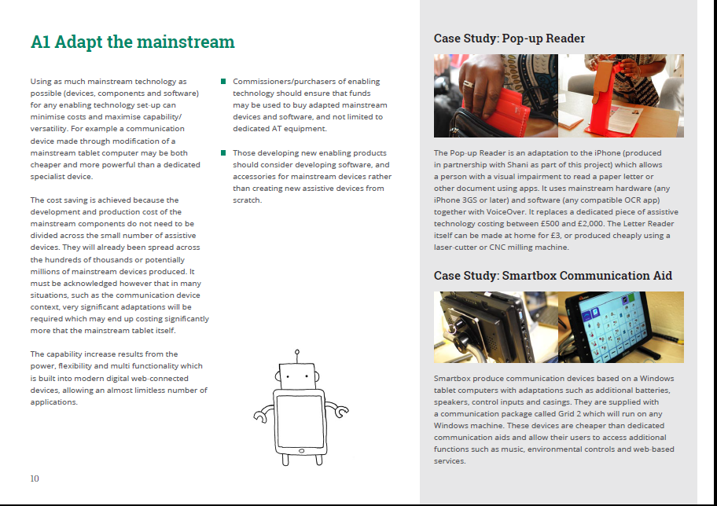
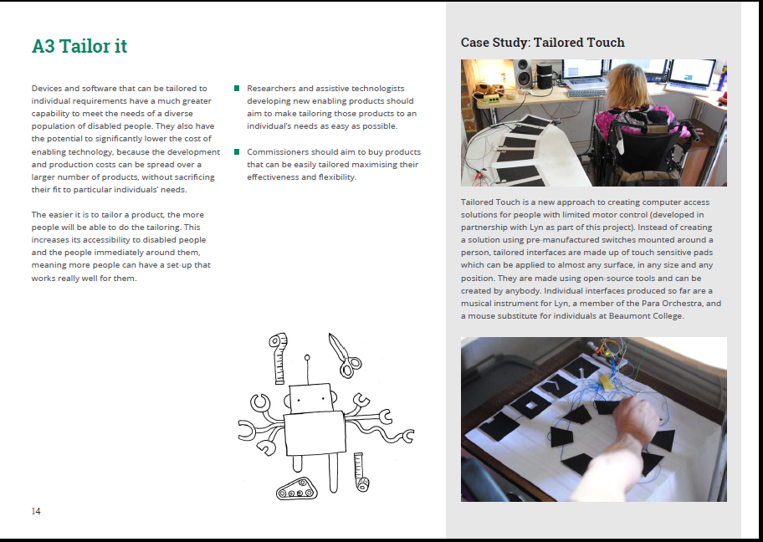
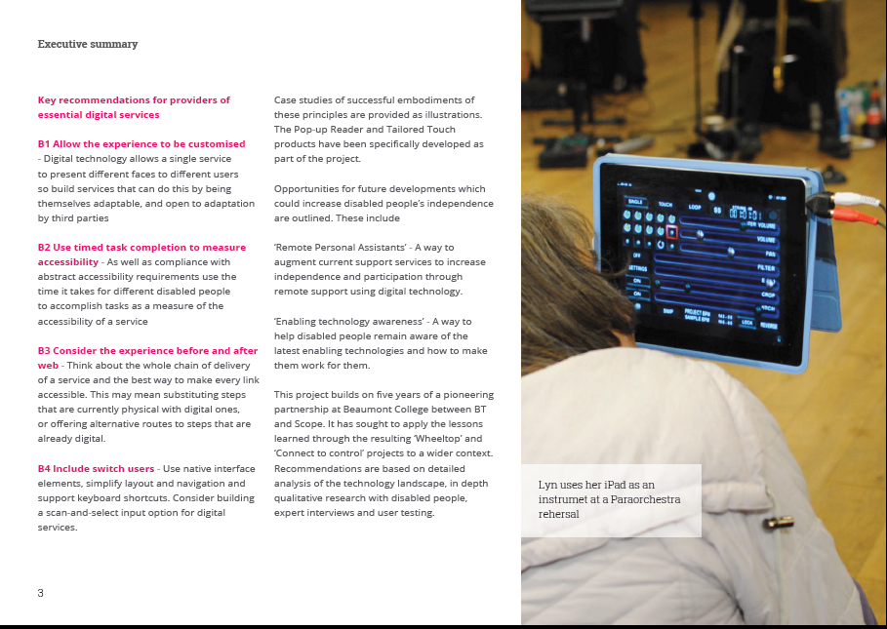
Notes:
The RCA report part of the project looking at barriers to inclusion
Information page
http://blog.scope.org.uk/2013/09/20/technology-for-disabled-people
Hashtag
#enablingtech
Stories live on BT’s external ingenious site:
How can technology work better for the UK’s 11 million disabled people?
- http://www.btplc.com/Innovation/Innovationnews/technology/index.htm
BT unveils accessibility prototypes
http://www.btplc.com/Innovation/Innovationnews/prototypes/index.htm
And coverage on the BBC amongst others
http://www.bbc.co.uk/news/technology-24171027
https://intra.bt.com/News/Pages/Disabled-people-liberated-by-technology-.aspx
http://home.bt.com/news/btlife/disabled-people-liberated-by-technology-11363837952843

Slide 17
We didn’t think we would create a music instrument, it was a Tailored Touch Interface that you can all make

Slide 18
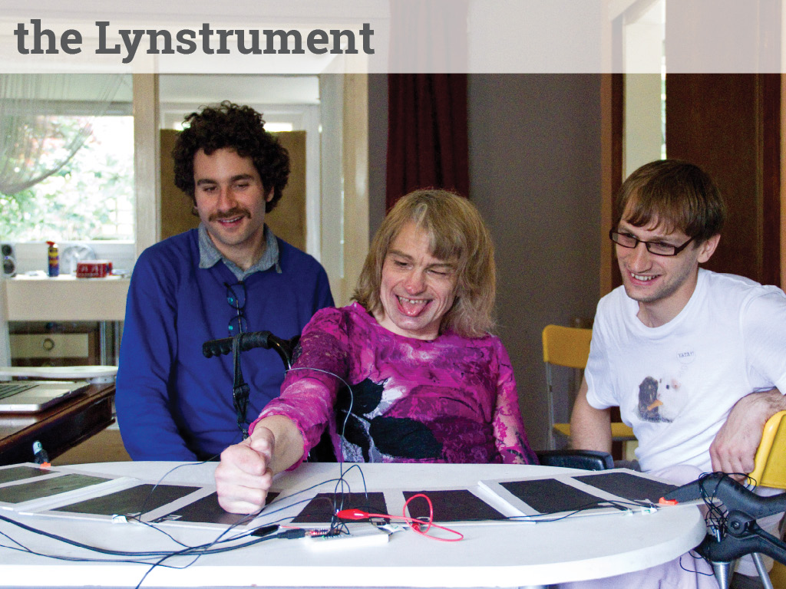
Our work with RCA and Scope helped people like Lyn Levett from the Paraorchestra thrive
It all began in the late 80's. Lyn bought a Commodore 64 inch computer from Boots that had a music package
Lyn has cerebral palsy and produces music on a Mac using Logic Pro. She uses a trackball to input notes and other actions. Lyn also has an iPad with several music apps and operates the pad with her nose.
Lyn is highly creative and has been described as producing the “most dizzyingly brilliant electronic music.”
Notes:
Lyn using her Lynstrument http://www.paraorchestra.com/musicians

Slide 19
And we met Shani
Notes:
Shani was a fun person to innovate with

Slide 20
A musician with a vision impairment, a handbag and a big personality

Slide 21
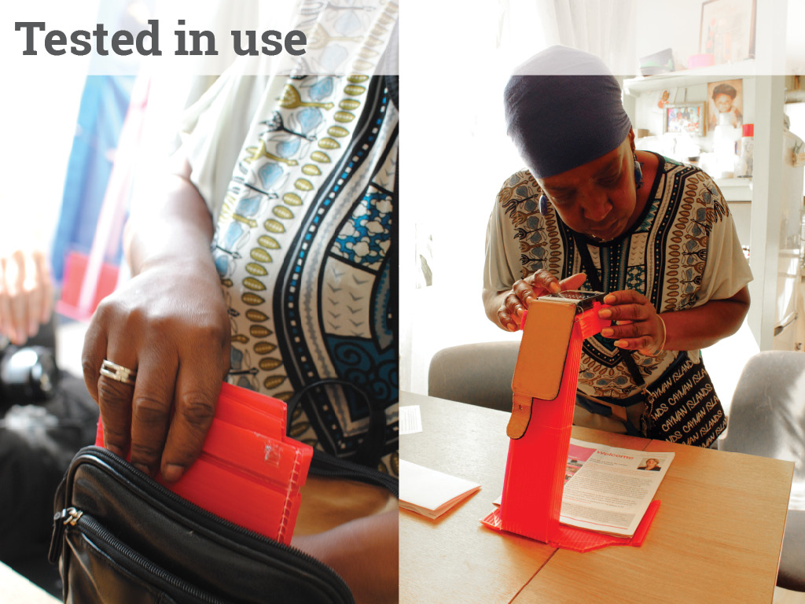
Notes:
Pop up reader to read text easily and tailored touch to make a large mouse based on conductive paint. Because Shani wanted it in her handbag

Slide 22
But we wanted to share all this innovation with people, so that anyone can benefit on Instructables

Slide 23
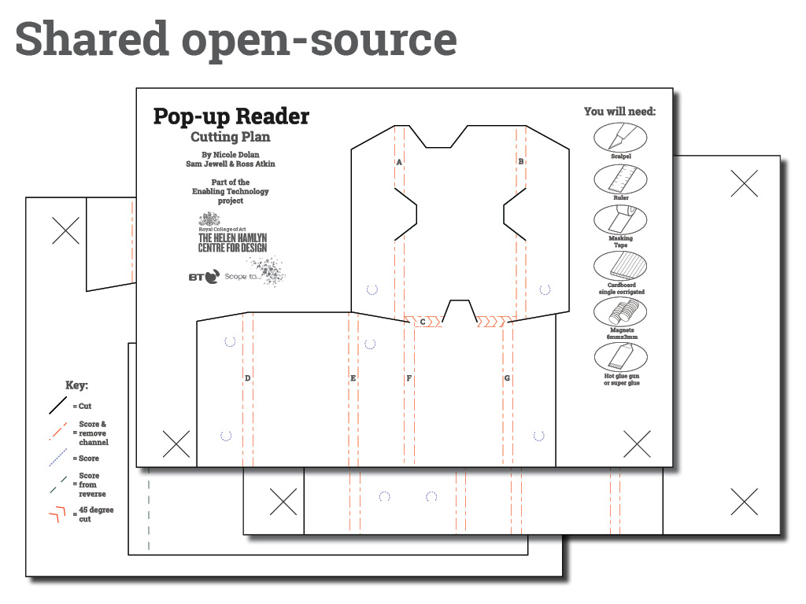
Notes:
Made open to all www.instructables.com

Slide 24
Lastly an option

Slide 25
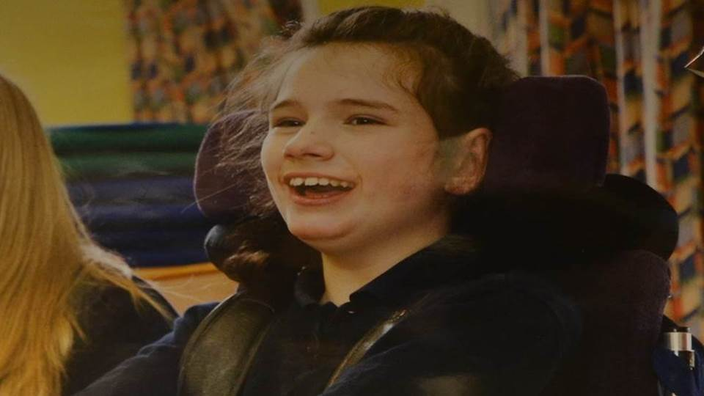
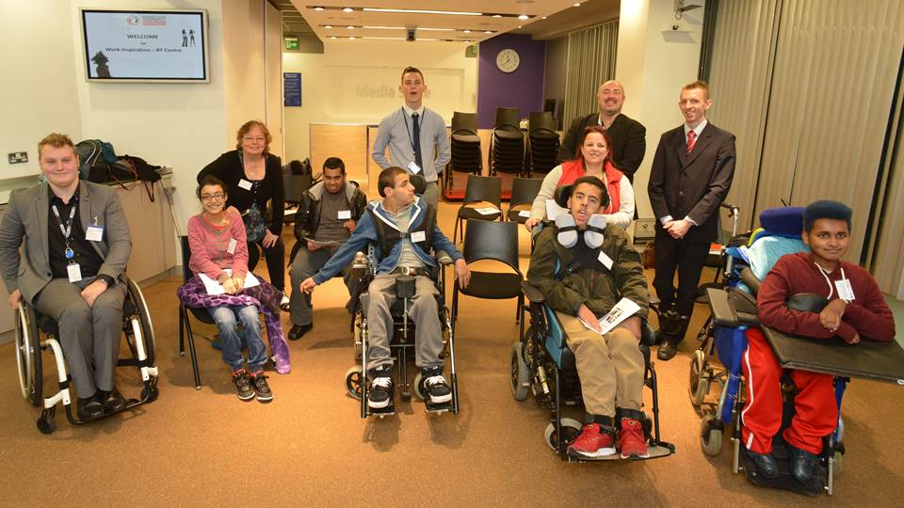
Which inspiring story do you want to hear?
Notes:
Katie who was called Kate who sent her first speaking message, on the right is are Scope students on a visit to BT Centre on Work Inspiration event

Slide 26
2012 legacy is all about creating an inspirational inclusive society, we are proud to be helping in a little way

Slide 27
Thank you
Adam Oliver adam.2.oliver@bt.com

