Slide 1

Open Source Technologies and the ATkit
E.A. Draffan ea@ecs.soton.ac.uk
Seb Skuse scs@ecs.soton.ac.uk
Magnus White mpw@ecs.soton.ac.uk
ECS Accessibility Team @AccessAtECS

Slide 2
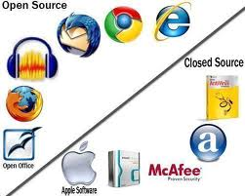
Overview
Open Source Software
  Licences
  Community
  Code
  Benefits
  Future development
What Is The Difference Between Open Source And Closed Source Software?
http://www.thegeminigeek.com/what-is-the-difference-between-open-source-and-closed-source-software/

Slide 3

Open Source Software
Distributed with source code – dependent on certain licences
Not the same as freeware or public domain
www.opensource.org
Notes:
Freeware– author chooses to give away software for free but with a standard licence and keeps the code and the right to adapt the software etc
Public Domain – the software is free and has no copyright so can be used by others in other applications

Slide 4
Licences
Around 58 possible licences – take care when you make your choice!
ATbar is being released under Berkeley Software Distribution (BSD) – this is the most open licence
Most popular - GNU General Public Licence 2.0 (GPL) - all derivative works must come under this licence. (http://osrc.blackducksoftware.com/data/licenses/)

Slide 5

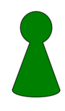
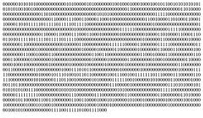

Community
Notes:
“Eric Raymond, in The Cathedral and the Bazaar, states that a necessary pre-condition for success is having 'something runnable and testable to play with'. It should be noted that 'runnable' does not mean perfect or even complete. 'Release early and often' is a well-known mantra of open source development, not least because doing so can attract invaluable early feedback and build confidence in the project. For this reason, communities should not be fearful or hesitant about putting out materials early; significant benefits can be realised by early releases provided expectations are managed clearly and truthfully.” OSS Watch

Slide 6
Why Community
Code
Community
Factor of Success
Time
farra@apache.org

Slide 7
Code
Often a main developer and small contributions from others
Make it possible to add small amounts of code to help a project e.g. Atbar plugins
Need to have agreement about the code that will be accepted
Open, online communication
Notes:
“... codebases that are more modular or have more option value increase developers’ incentives to join and to remain involved in an open source development effort; and decrease the amount of free-riding in equilibrium.’
The Architecture of Participation:
Does Code Architecture Mitigate Free Riding in the
Open Source Development Model
Baldwin and Clark, 2005
http://www.people.hbs.edu/cbaldwin/DR2/BaldwinArchPartAll.pdf

Slide 8
Benefits
Encourages collaborative working
Good publicity
Makes you write good code!
Problems shared – bug tracking, issues raised, comments made, new ideas.
Future developments

Slide 9

Access Tools pendrive
Distributed on USB flash drives and as downloads.
Useful open source and freeware tools which require permission to redistribute.
Developers of AT have generally been willing to allow distribution.

Slide 10
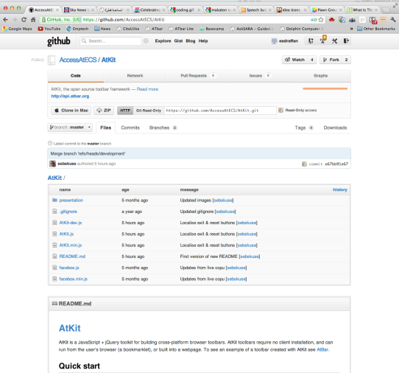
ATkit – the Framework
https://github.com/AccessAtECS/AtKit

Slide 11
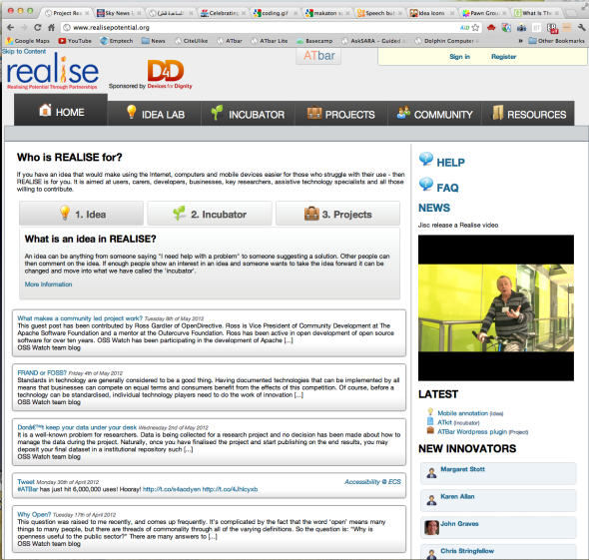
Future Developments

Slide 12
Thank you
ECS Accessibility Team
http://access.ecs.soton.ac.uk

